Slide 1
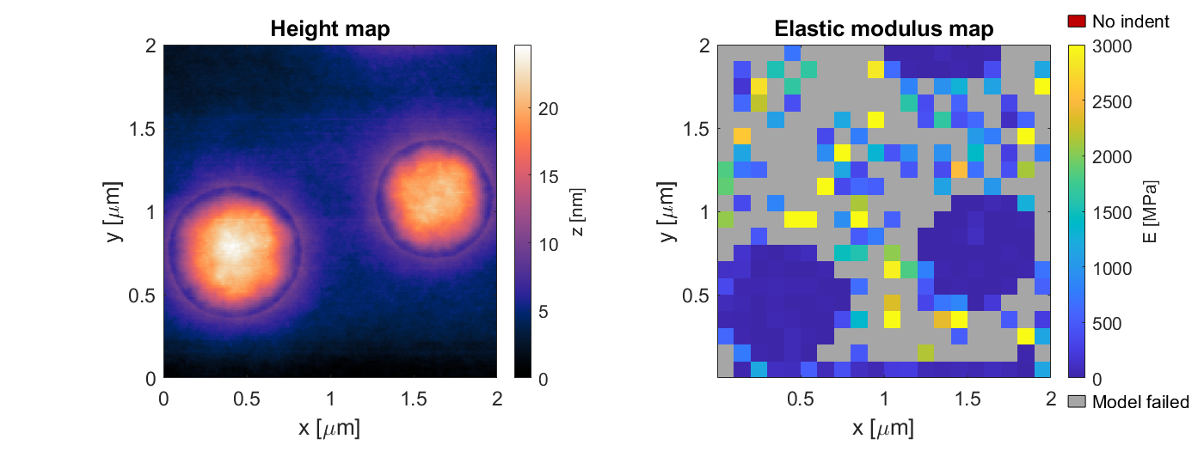
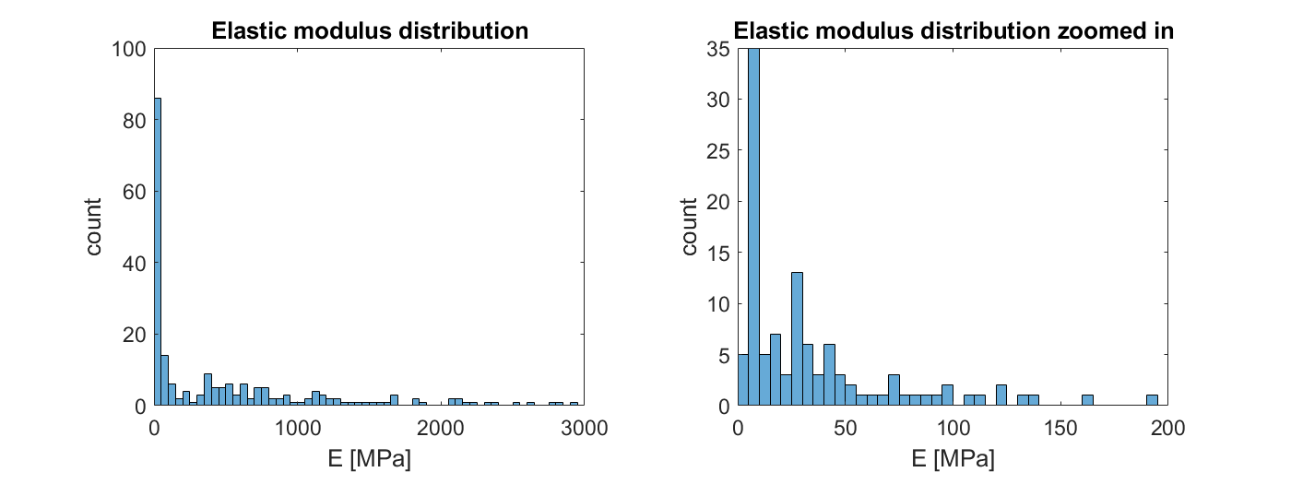
PS-LDPE EXP111
0 - 3000 Mpa
R^2 > 95%
n = 15

Slide 2
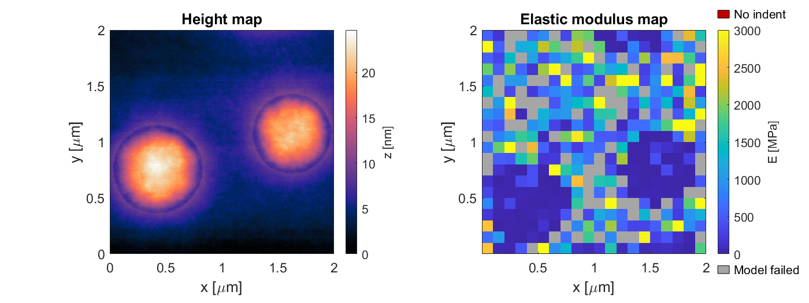
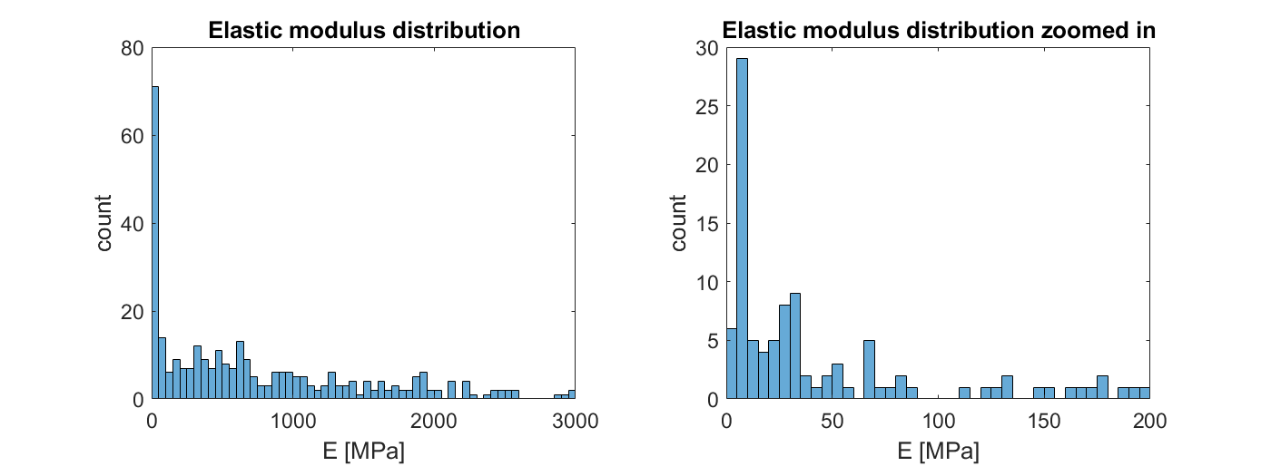
PS-LDPE EXP111
0 - 3000 Mpa
R^2 > 95%
n = 12

Slide 3
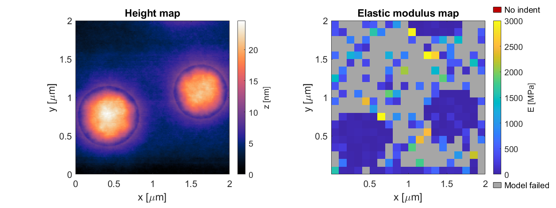
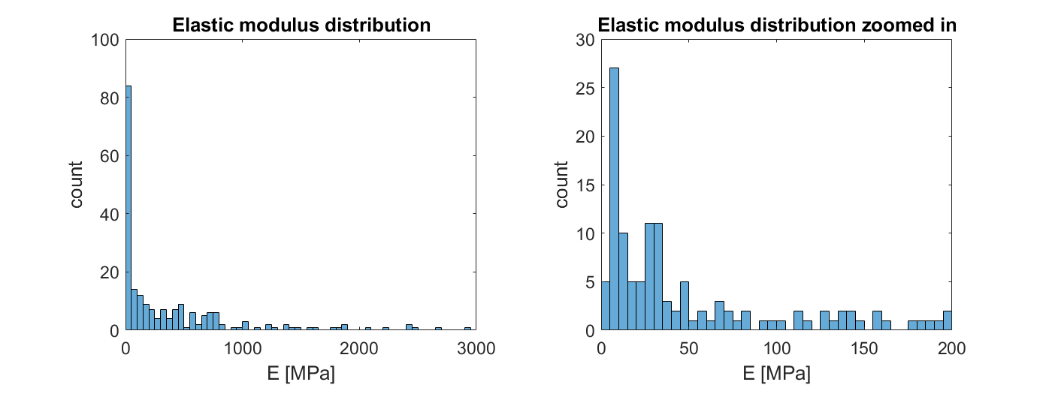
PS-LDPE EXP111
0 - 3000 Mpa
R^2 > 95%
n = 10

Slide 4
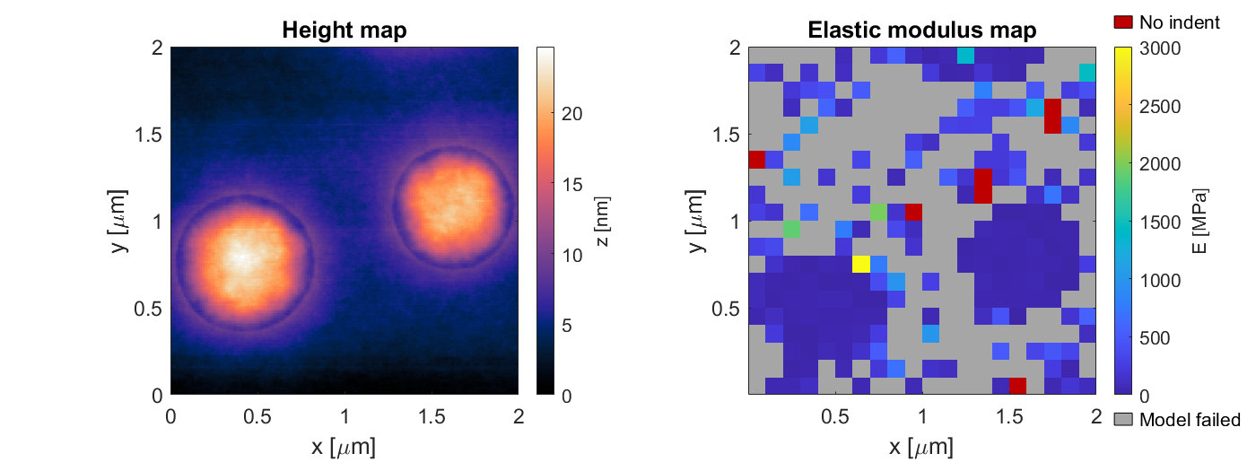
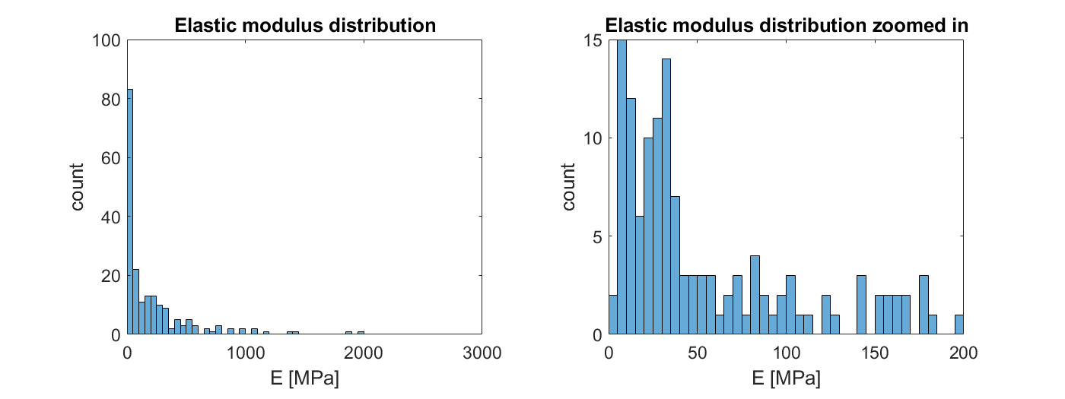
PS-LDPE EXP111
0 - 3000 Mpa
R^2 > 95%
n = 5

Slide 5
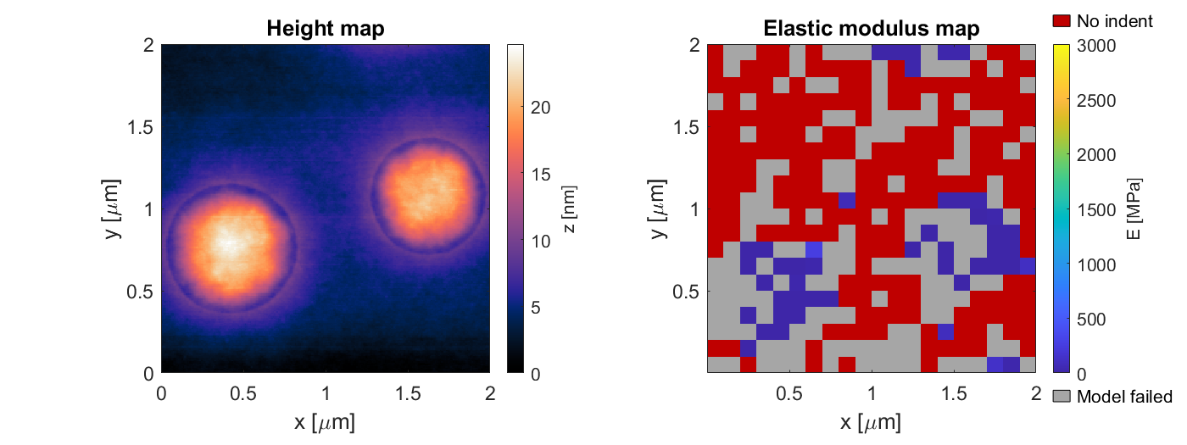
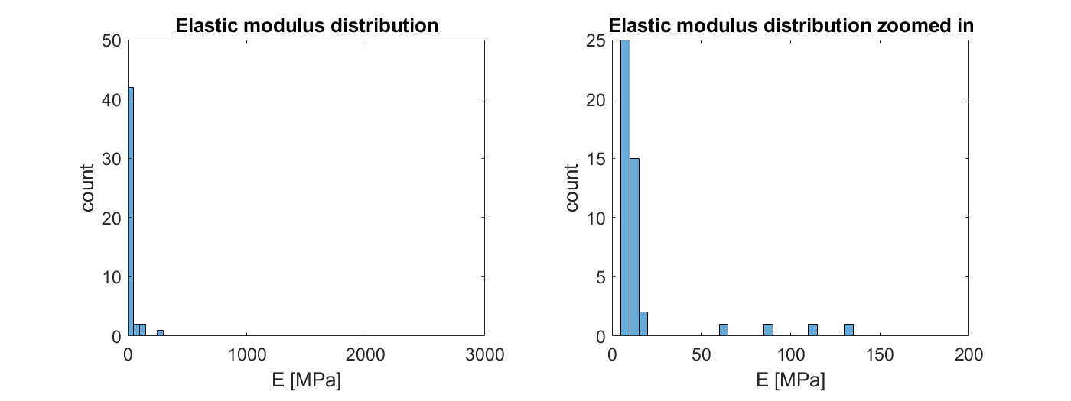
PS-LDPE EXP111
0 - 3000 Mpa
R^2 > 95%
n = 1

Slide 6
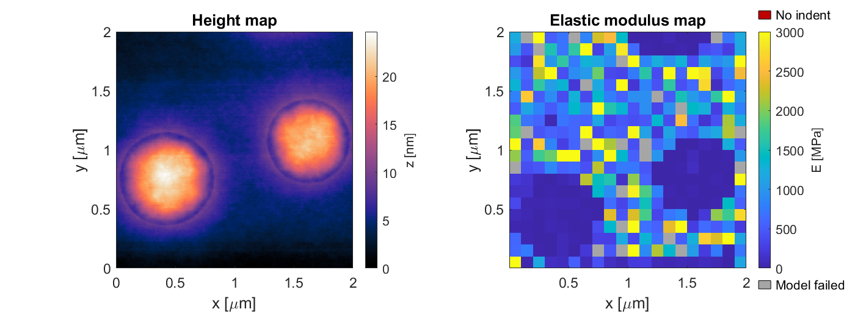
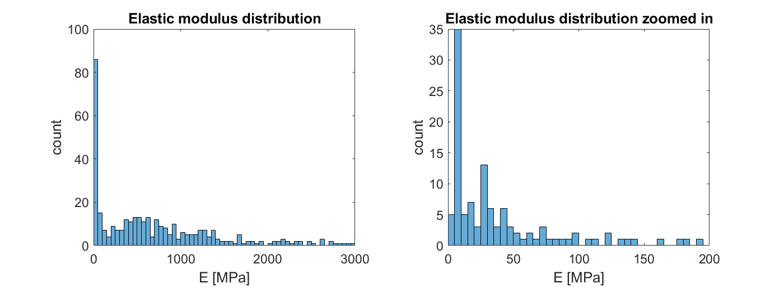
PS-LDPE EXP111
0 - 3000 Mpa
R^2 > 80%
n = 15

Slide 7
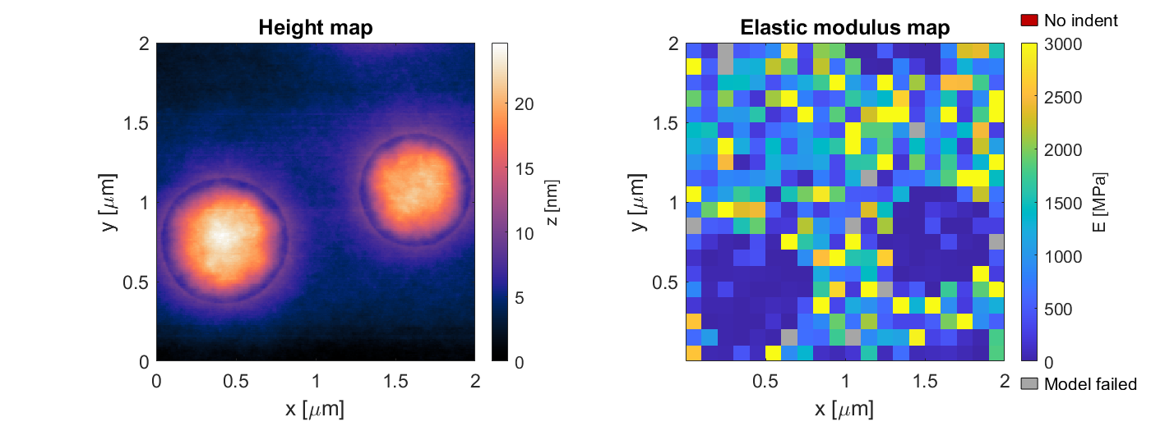
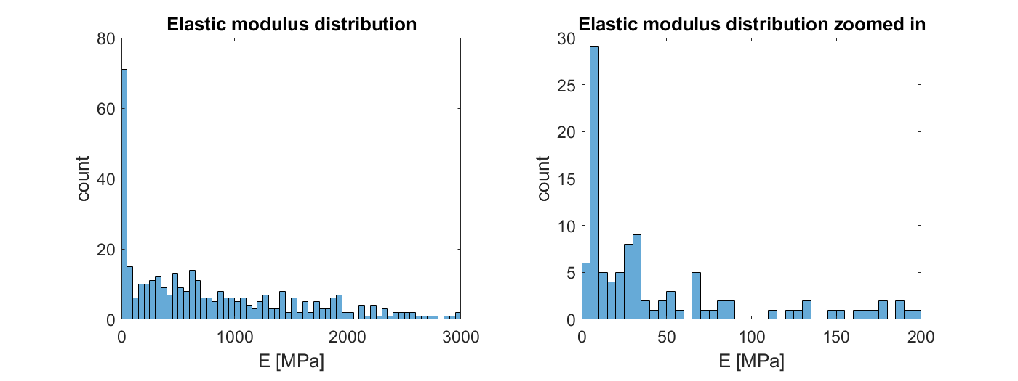
PS-LDPE EXP111
0 - 3000 Mpa
R^2 > 80%
n = 12

Slide 8
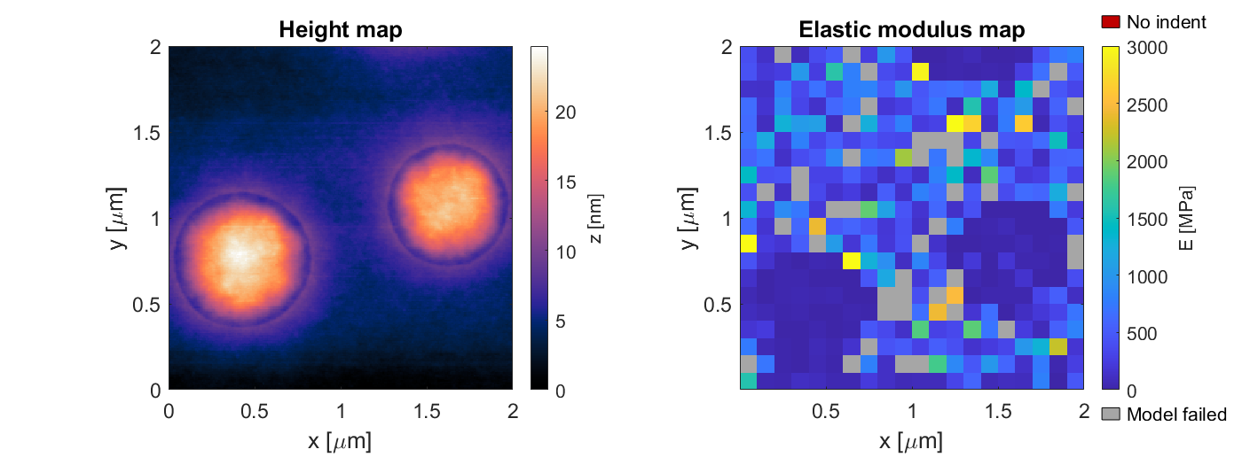
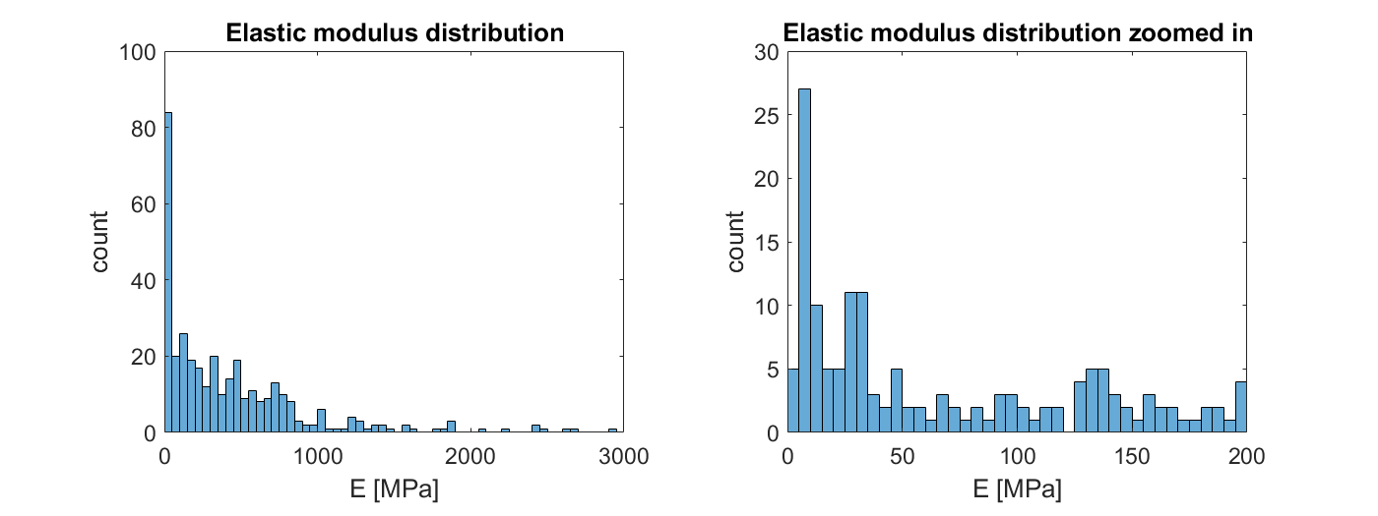
PS-LDPE EXP111
0 - 3000 Mpa
R^2 > 80%
n = 10

Slide 9
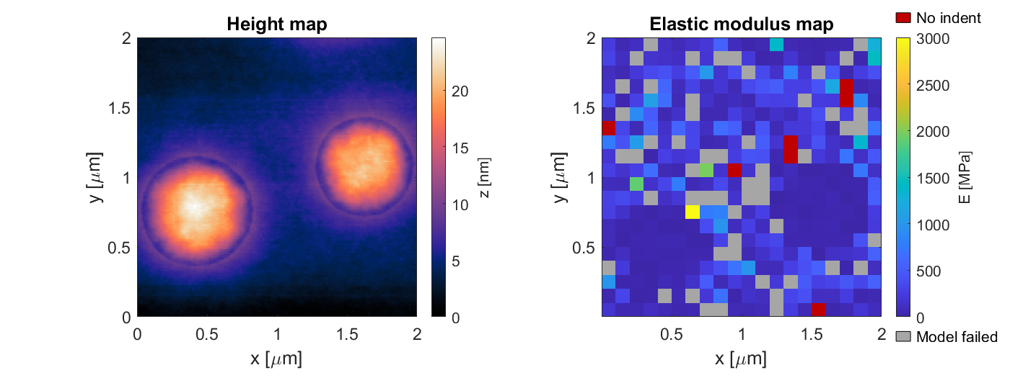
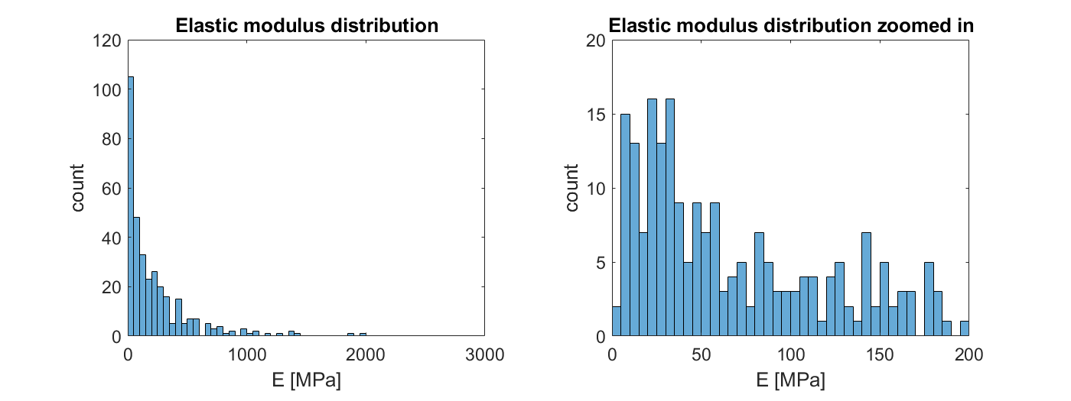
PS-LDPE EXP111
0 - 3000 Mpa
R^2 > 80%
n = 5

Slide 10
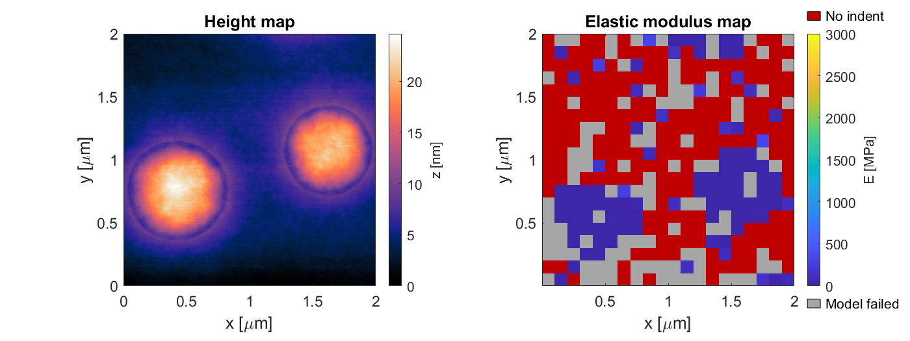
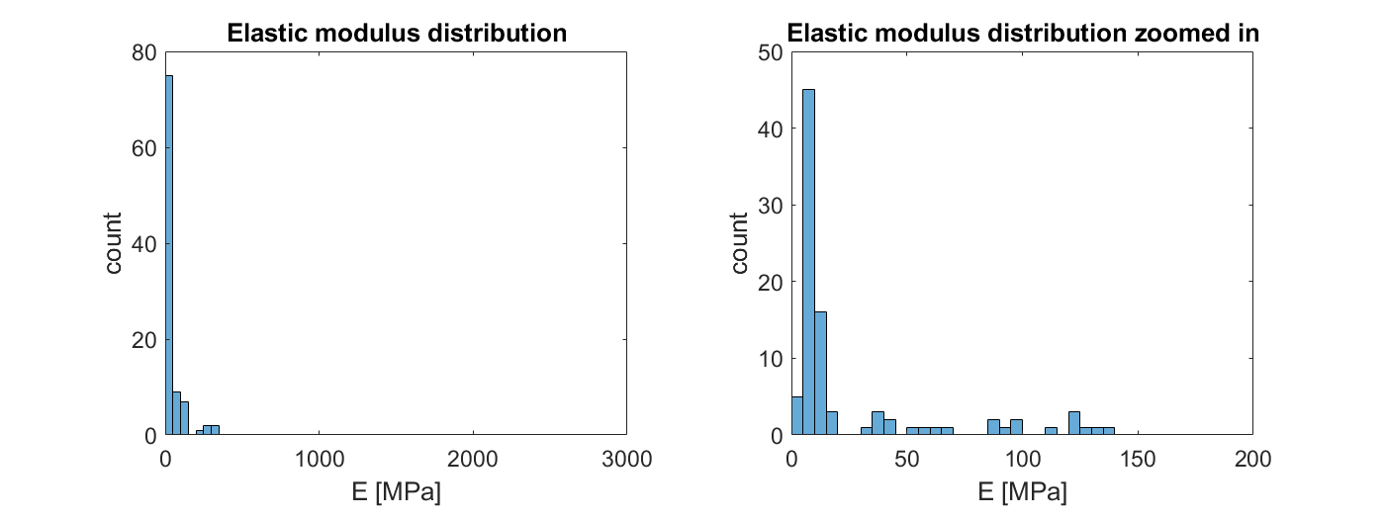
PS-LDPE EXP111
0 - 3000 Mpa
R^2 > 80%
n = 1

